Slide 1

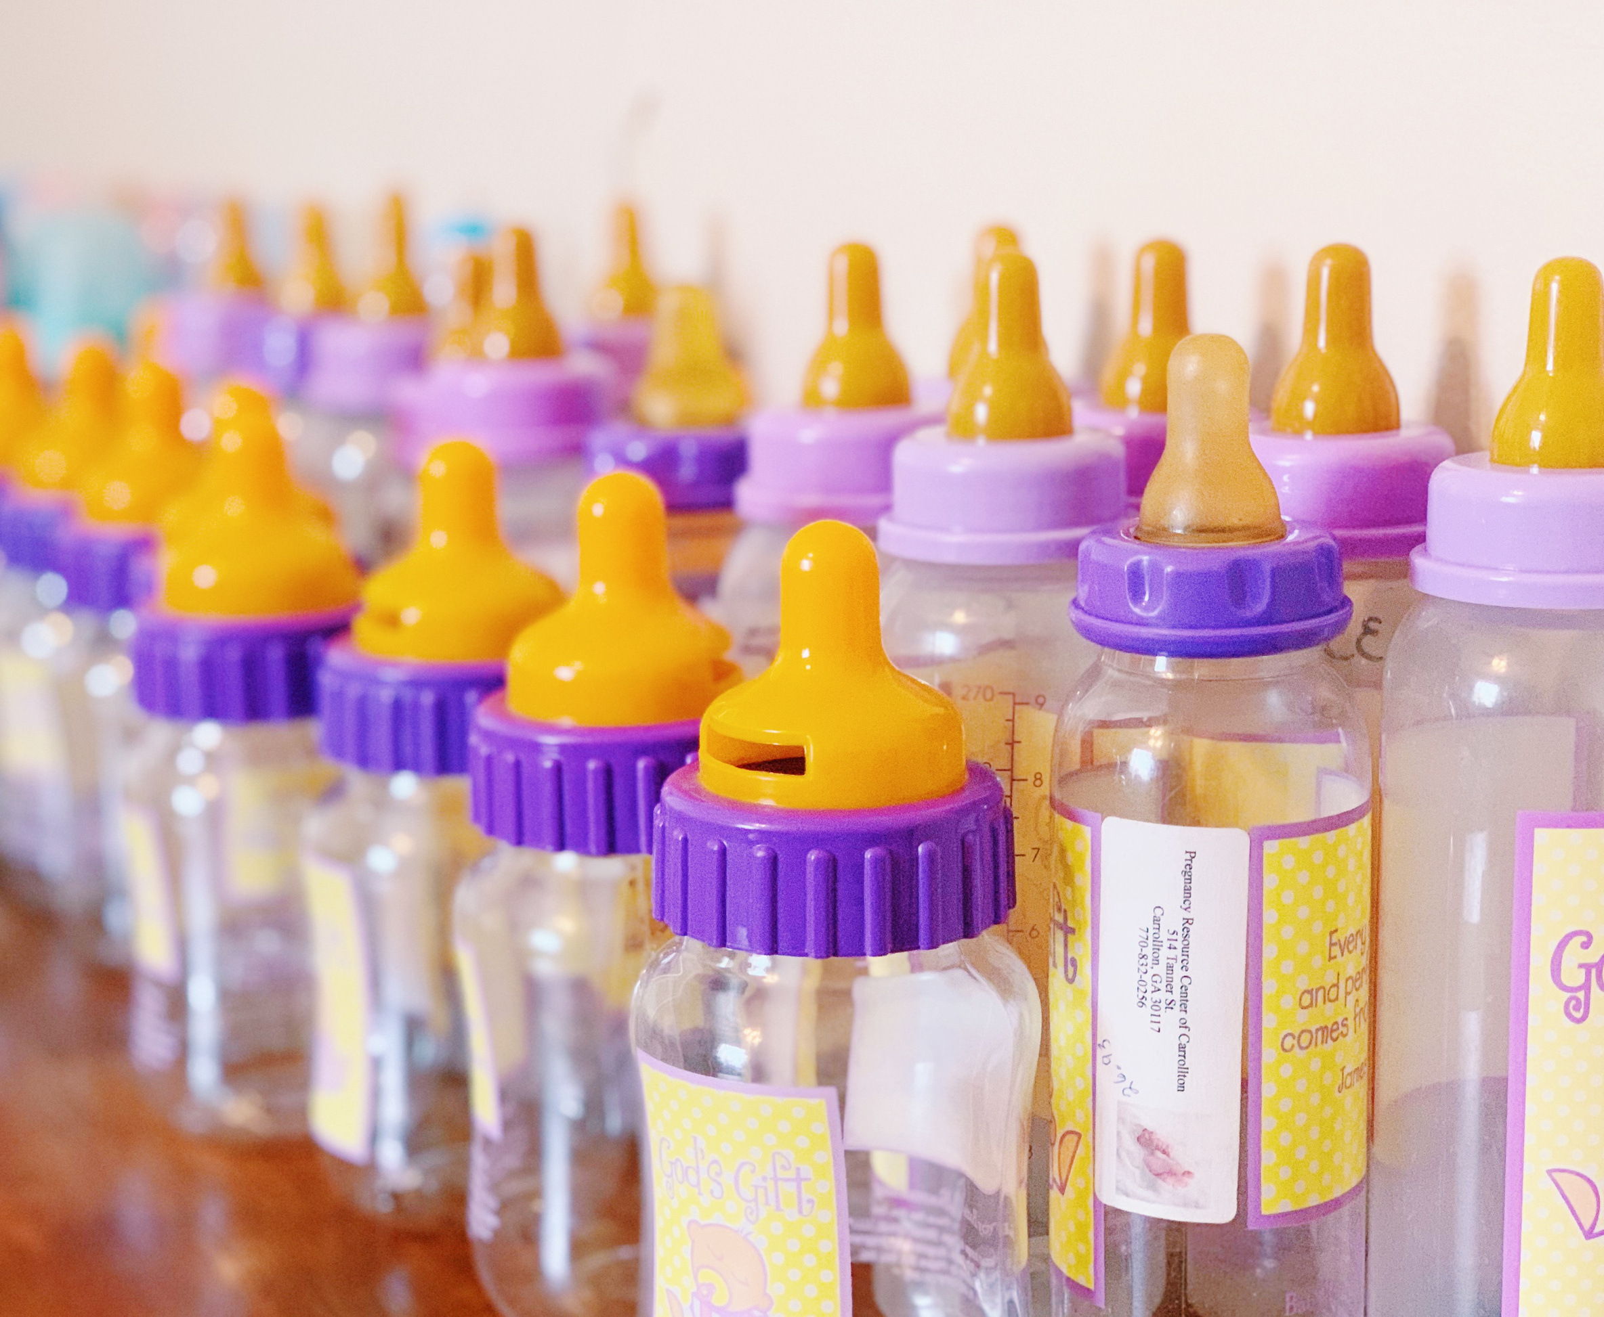





Baby Bottle
BOOMERANG

Slide 2
You Can Help Fund God’s Miracles
Do you have a heart to help those in need? Want to make an eternal impact in the Kingdom of God?
Beginning on Sanctity of Life Sunday, you can fill a bottle with spare change or an envelope with cash or checks. You can also donate online by scanning the QR code on the Baby Bottle Boomerang flyer. Your gift makes an impact with women and men in the community facing unplanned pregnancies and the lives of their unborn babies. Please return all bottles and envelopes to your designated drop off location.

Slide 3
Ascend Women’s Care & Family Support Fast Facts
  In 2025, Ascend served 412 abortion-minded and at-risk women.
  In 2025, Ascend conducted 740 pregnancy tests, 558 ultrasounds, 336 advocacy appointments, and 208 Parenting Plus classes.
  In 2025, Ascend distributed 350 material goods packs (gently used clothing, diapers, formula).
  Our largest age group is 20–24-year-olds.
  In the past year 75% of the women served were unmarried.
  Every client who walks through the doors of Ascend has the opportunity to hear the Gospel and receive prayer.

Slide 4
Donate online at www.ascend/bbb2026
Visit us for a tour. For more information www.ascendwga.com/tours
Contact us with any questions or for support at 678-390-7861 or grakestraw@ascendwga.com

